Slide 1
Ohio Farm to School Newsletter
National, Regional and State Updates
OHIO STATE UNIVERSITY EXTENSION
September 2017
Announcing the 9th National Farm to Cafeteria Conference
Save the date for the 9th National Farm to Cafeteria Conference, coming to Cincinnati, Ohio, April 26-27, 2018! Hosted by the National Farm to School Network, this biennial event will convene more than 1,200 movement leaders working to source local food for institutional cafeterias and foster a culture of healthy food and agricultural literacy across America.
Cafeterias in schools, early care and education settings, universities, prisons and hospitals serve more than 40 million Americans every day, placing the farm to cafeteria movement at the forefront of the fight to end obesity and strengthen local food systems and economies. The National Farm to Cafeteria Conference is the only national gathering of stakeholders from across this movement, making it the premiere opportunity to learn, network and collaborate with likeminded leaders from across the country. Registration will open in January 2018 – mark your calendar now!
Contents:
Farm to School Update…….. Page 2
Success Story……………….. Page 3
News ………………................ Page 4
Sponsors……………………… Page 5

Slide 2
Ohio Updates
National Farm to Cafeteria Conference coming to Ohio in 2018
By Carol Smathers Ohio Farm to School Director
America’s premier Farm to School conference
Every two years the National Farm to School Network (NFSN) brings together Farm to School leaders and supporters from around the country. Participants share the latest farm to school challenges, innovations, approaches, and successes related to selling/purchasing, serving, and teaching about local foods in schools, hospitals, and other institutions. There were over 1000 attendees at the previous Farm to Cafeteria conferences held in Austin, TX (2014) and Madison, WI (2016).
National Farm to Cafeteria Conference
Duke Energy Convention Center
Cincinnati, Ohio
April 25-27, 2018
* Local Lunch Leaders* - April 25
Ohio Farm to School Pre-conference
Open to all – registration required
NFSN Annual Meeting - April 25
Invitation only
Conference Sessions - April 26
Ohio Welcome
Plenary Speakers
Workshops and posters
Field Trips – April 27
Witness the finest the area has to offer related to procurement, processing, preparing, and teaching about local foods.
Networking and learning opportunities
Representatives from each state serving as “Core Partners” to the National Farm to School Network will be in Cincinnati for this event. We’re expecting a large turnout of producers, processors, school food service staff, and educators from our mid-west region, and especially from around Ohio.
Attend special networking events and/or make valuable connections during conference sessions, meals, and breaks.
GET INVOLVED!
Contact Amy Fovargue at Fovargue.1@osu.edu to offer ideas or get involved with the following:
Share your ideas with the host state planning committee
Have a great idea for what you would like to experience at the conference? Contact us now!
Bring a team to the Ohio “Local Lunch Leaders” Pre-conference
School food service directors from large and small districts across Ohio will share their recent successes serving locally procured meals each month. Practical information you can use for planning, affording, and promoting local meals will be shared. Watch for more details.
Be a presenter at the National Farm to Cafeteria Conference
Do you have expertise to share? NFSN will be seeking proposals for conference presentations (workshops, posters, etc.) from stakeholders interested in sharing their models and strategies for making farm to cafeteria initiatives a reality in their communities. The Request for Proposals will open in September. Watch the NFSN and Ohio Farm to School websites for additional information.
Host a Field Trip
Do you have a perfect site for demonstrating exciting approaches for bringing the farm to the cafeteria or for reducing barriers and increasing equity within local food systems? Contact Amy Fovargue by October 1 to discuss what your site has to offer. Site honorarium may be available.

Slide 3
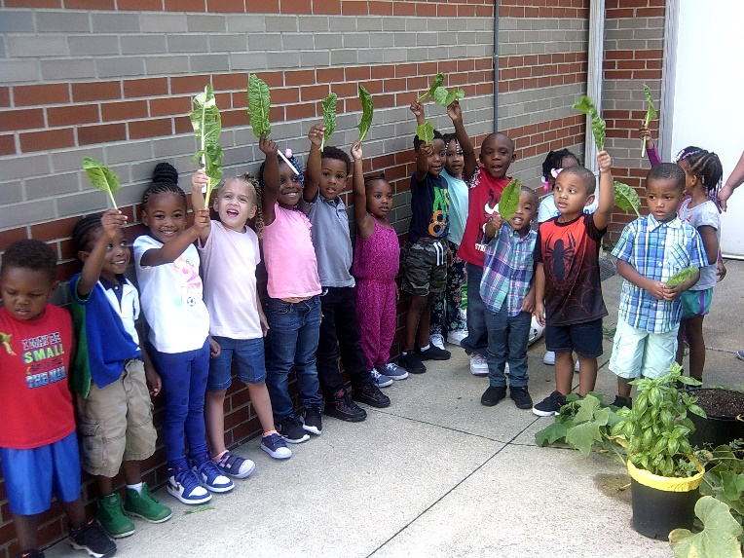
Ohio Success Story
CEOGC Louis Stokes Head Start Center Children Garden
By Amy Fovargue
A Head Start in Cleveland has a children’s garden that has taken roots and helped to provide nutrition education and fresh produce for the students and their families. Their goals for having their garden is to encourage children and parents to eat more fruits and vegetables, as well as teaching families to have gardens at home. They encourage their families to consume a variety of foods and exercise more.
Thelma Bizzell, site administrator at the CEOGC Louis Stokes Head Start, explained the interest in gardening began at their site in 2013 after one of the teachers read the children’s book Up Above and Down Below to their classroom. The students had expressed a curiosity about plants so the teachers began to foster that curiosity by starting plants in cups in the classroom. The students were amazed while watching potatoes grow in pots. Since then, their actual growing area has increased. The following year they expanded their project by growing vegetables in containers outside, then in 2015 they grew four full rows in the ground. Thelma grew up on a farm in Alabama, so she is the “go to” person for the garden.
“We started growing a variety of items that the children and their parents had never seen. For instance eggplant, the parents were not aware that you could eat something purple. A few of the parents did not want to be a part of it at first, but once they tried the vegetable they were excited,” said Thelma. The preschoolers just glow when they talk about the foods we grow here. They take ownership and they want to share it with their family, continued Thelma.
The facility has more than 340 preschoolers, which are growing some foods that are then prepared in the on-site kitchen. Besides their garden, they have recently constructed an outdoor classroom. When it is complete, the outdoor classroom will include benches and stools, water tables, a sand area, digging beds, planting areas and a musical area with an instrument and stage. This space will encourage teacher and parental involvement
and will allow students to learn in a different environment than the classroom.
Louis Stokes received a $2,000 mini grant from the Cuyahoga County Health Department. With those funds, they bought 350 containers gardens so each child could grow food at home. There is a lot of enthusiasm by the families served by the garden.
Thelma said, earlier this year we had parents asking us what we were going to plant in the garden. Whenever the kids pick produce, we will have a party. The kids then eat a fresh salad with their lunch. They serve family style and try to encourage the children to talk about what they are eating at lunch. They also incorporate our fruits and veggies into the menu and encourage their parents to use fresh fruits and vegetables at home.
The Ohio Healthy Program recognizes the Louis Stokes Head Start Center. This is a project lead by The Ohio Child Care Resource & Referral Association (OCCRRA), which offers early care, and education programs the opportunity to earn a designation. Steps toward this designation include attending Ohio Approved professional development, which uses the Healthy Children, Healthy Curriculum, implementing a wellness policy, improving menus and engaging families.
Thelma said, with the Ohio Healthy Program certified their school for teaching about food and nutrition. We send literature home the families to try to combat obesity. We also have workshops for the parents on how to play fun games to keep them moving and keep their children fit.
“We are a unique child development program. We are a family and community engaged center that works with children and families. There is nothing that we cannot accomplish! We see growth and have hope with our parents, children and grandchildren. We wish that everyone could come and check out our outdoor garden and classroom and our enthusiasm will spill over into everything we do,” Thelma concluded.

Slide 4
News
NFSN Farm to Early Care and Education Quarterly Webinar:
Farm to Early Care and Education and Head Start – A Natural Alignment
Tuesday, October 10, 3-4 PM ET
Head Start offers vital, high quality early care and education (ECE) opportunities to low-income families across the country. Farm to ECE offers benefits that support the goals and priorities of the ECE community, with a particularly strong alignment with Head Start priority areas, including an emphasis on experiential learning opportunities, parent and community engagement, and life-long health and wellness for children, families and caregivers. Join this webinar to learn about the exciting new resource from NFSN, “Growing Head Start Success with Farm to Early Care and Education,” which aligns Head Start Program Performance Standards and the Early Learning Outcomes Framework with farm to ECE opportunities. To register: https://register.gotowebinar.com/register/6849804993390528257
Calling all CACFP ACTIONEERS! ​ Let’s celebrate the New CACFP Meal Pattern Implementation and take the CACFP take Action Challenge of the Month http://www.cacfptakeactionchallenge.org/.Submit your CACFP menus in the ENTER YOUR CACFP MENUS Celebration. Get your CACFP Child Care business or CACFP Sponsor Organization featured in the CACFP Meal Pattern Implementation Library. http://ccfprtconference.weebly.com/cacfp-meal-pattern-implementation-library.html
Enter Your CACFP Menus for a chance to win a $100 gift card or donate to your favorite Non Profit! Email them to ccfprtconference@gmail.com.
Ohio School Garden Conference October 13 // Columbus, OH Educators, after-school personnel and interested public are invited to attend the Ohio School Garden Conference. Planned discussions include garden-based nutrition education, after-school gardening, hands-on activities and more. To register: go.osu.edu/sgc2017.
On-going resources:
Finding local farms, buyers, or restaurants that purchase/ serve local foods, visit Ohio MarketMaker: www.ohiomarketmaker.com
Finding farms in and around Ohio that sell directly to the public through local farmers' markets, CSA's, and on-farm sales, visit OEFFA’s Good Earth Guide http://www.oeffa.org/search-geg.php
GroundWorks Community URL: www.edweb.net/schoolgardens
Ohio Proud is a resource for identifying local farms and food producers: http://www.ohioproud.org/
National Farm to School Network http://www.farmtoschool.org/about

Slide 5
Thank you to all of our partners and supporters!
Ohio Farm to School Newsletter
Authors:
Carol Smathers, Ohio Farm to School State Lead
Amy Fovargue,
Healthy Living Program Coordinator
For Ohio Farm to School inquiries or to submit information, e-mail farm2school@osu.edu
Follow Ohio Farm to School on Facebook
CFAES provides research and related educational programs to clientele on a nondiscriminatory basis. For more information: go.osu.edu/cfaesdiversity.

